Slide 1
Photosynthesis Review
Answers

Slide 2
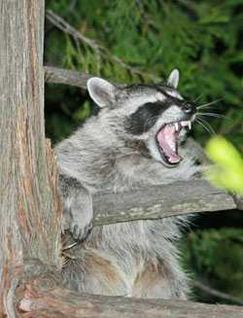
Warm Up
Write two observations
Write two inferences

Slide 3
Station: Inputs Copy the table into your notebook and fill in with your group. Use both words AND illustrations in each box.
What are the inputs to photosynthesis? | Where do each of these come from? | How do each of the inputs enter the plant?
Carbon Dioxide Water Sunlight | Gas from the air, produced by animals. Water from rain. Sunlight from the sun…yeah… | Gas comes in through the leaves Water comes up through the roots. Sunlight gets absorbed through the chloroplasts in the leaves.

Slide 4
Station: Outputs Copy the table into your notebook and fill in with your group. Use both words AND illustrations in each box.
What are the Outputs of Photosynthesis? | How do they Exit the plant?
Glucose (energy from sugar) Oxygen Water | Glucose = fruit! Fruits contain the sugars Oxygen = leaves through the leaves Water = leaves through the stem

Slide 5
Station: Plant Mass
To be Superman and pick up a tree would be fantastic! I would have superhuman strength!
Answer the questions below in your notebook
Where does a tree’s mass come from? CO2
How do you know? Molecules!
How could you figure it out?
Grow plants with and without
CO2 and see what happens.

Slide 6
Station: Equation
Copy and answer the questions into your notebook.
What is the chemical equation for photosynthesis? Memorize!
6 H2O + 6 CO2 → C6H1206 + 6O2
Why is photosynthesis important to living things that are not plants –like us animals? (a.k.a. what benefits to plants provide?)

Slide 7
Station: Sunshine Reading
Photosynthesis occurs in two stages. What are they? How do they work together? Where do they occur?
Light dependent reaction → Plant captures sunlight, water and carbon dioxide.
Light independent reaction → Plant rearranges the molecules into sugar and oxygen
Why are most plants green?
Chlorophyll! The chemical that captures sunlight is green.

Slide 8
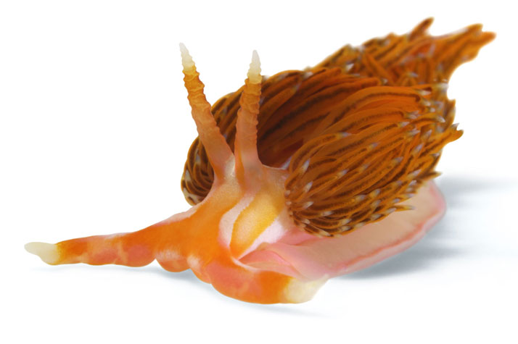
Station: GROWER
Answer the question in your notebook
What are the characteristics of life that GROWER stands for? How does a slug represent each of these characteristics?

Slide 9
Slugs and GROWER
G-Growth, slugs grow.
R-Reproduction, slugs reproduce.
O-organization, slugs have organized units called cells.
W- water, slugs need water.
E- energy, slugs need to take in energy by eating.
R- respond and adapt, slugs respond to stimulus, like salt, and adapt to survive, like avoiding salt.

